Slide 1

Module 0
Introduction to R
Notes:
Guidelines
Use section headers to chunk content in your presentation.
Use the same style of section header throughout your presentation.
Keep your title to no more than 2 lines.

Slide 2

Reading Data into R
Notes:
Guidelines
Use a title slide at the beginning of your presentation. There are 9 variations of title slides to choose from.
If you will have a series of slideshows, we recommend using the same style of title slide for each presentation.
Keep your title to no more than 2 lines.
Do not change the font style or font size of the title or subtitle.

Slide 3
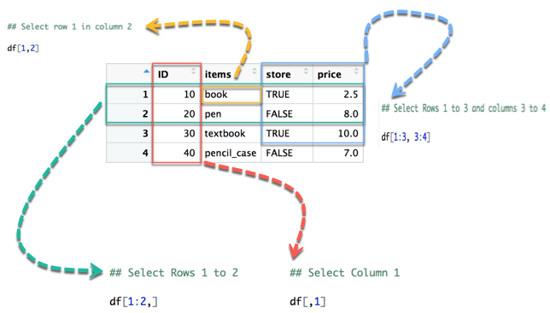
Data Structures – Data Frames
Similar to matrices but can contain different data types

Slide 4
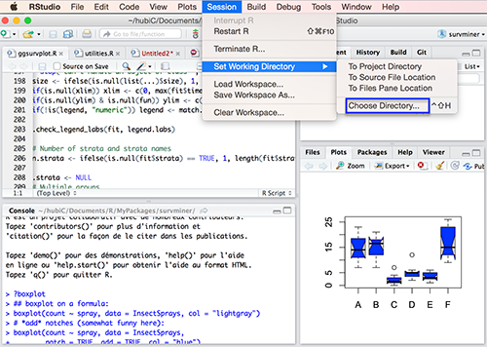
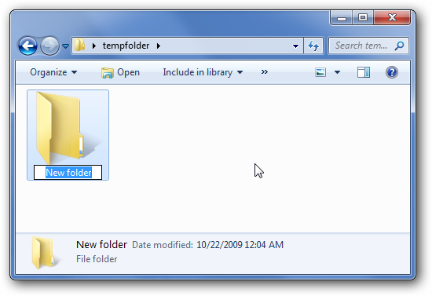
The Working Directory
Save your data and scripts in a folder
The working directory tells R where to find those files

Slide 5

Using Code to set Working Directory
Save your data and scripts in a folder
The working directory tells R where to find those files
PATH

Slide 6
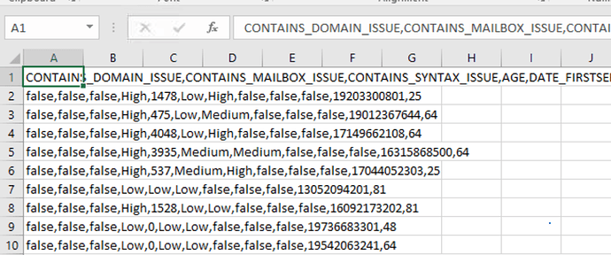
Reading Data
The main functions to read text data (.csv, .txt) are:
read.csv()
read.table()
COMMA SEPARATED

Slide 7
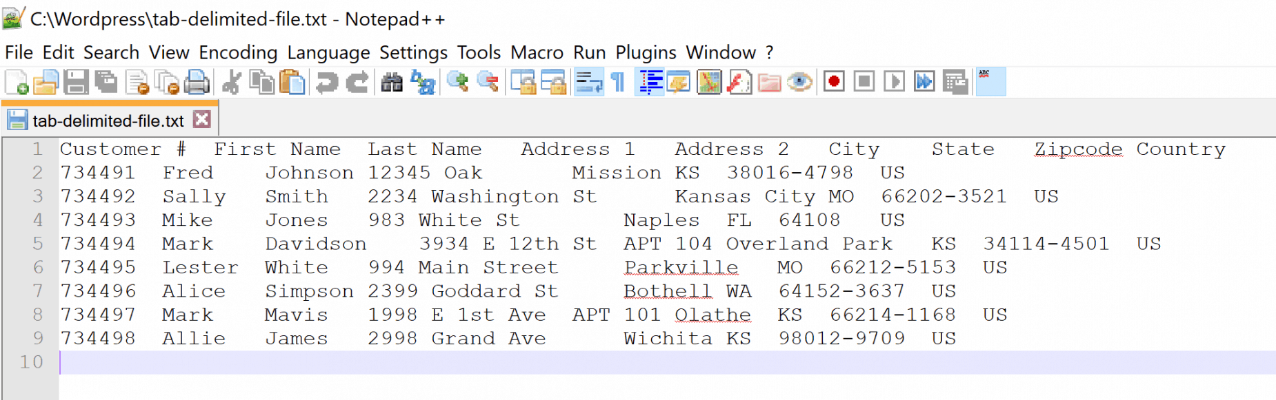
Reading Data
The main functions to read text data (.csv, .txt) are:
read.csv()
read.table()
TAB SEPARATED

Slide 8


For the data here, what would be the separator to use:
ⓘ Start presenting to display the poll results on this slide.

Slide 9
Headers
A header indicates whether the first row contains the variable names:
header = T

Slide 10
Reading Data
The main functions to read text data (.csv, .txt) are:
read.csv()
read.table()
Example using read.csv()function :
df = read.csv(“file.csv”, stringsAsFactors = T)
Name of Object
assigned
File name with PATH
e.g.
“/users/files/file.csv”
“github.com/user/file.csv”
Converts all character variables to type factor

Slide 11
Reading Data
The main functions to read text data (.csv, .txt) are:
read.csv()
read.table()
Example using read.table()function :
df = read.table(“file.txt”, sep = “\t”, header = T, stringsAsFactors = T)
Name of Object
assigned
File name with PATH
e.g.
“/users/files/file.txt”
“github.com/user/file.txt”
Changes separator to TAB
Reads first line as variable names

Slide 12
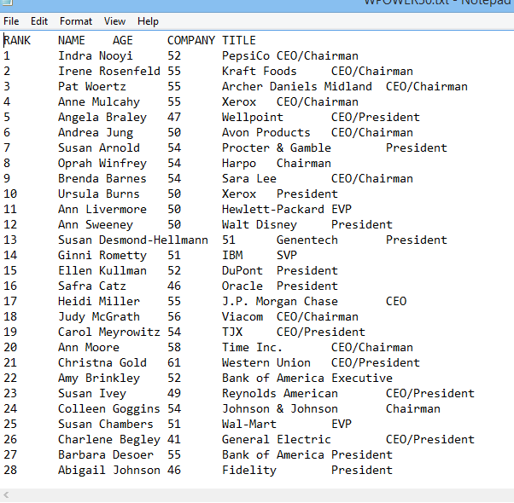
Let’s Read the POWER50.txt dataset
How is it delimited (separated)?
Do we use header = T or F

Slide 13
What separator should we use?
ⓘ Start presenting to display the poll results on this slide.

Slide 14
Should we use header = TRUE?
ⓘ Start presenting to display the poll results on this slide.

Slide 15

Practice

Slide 16
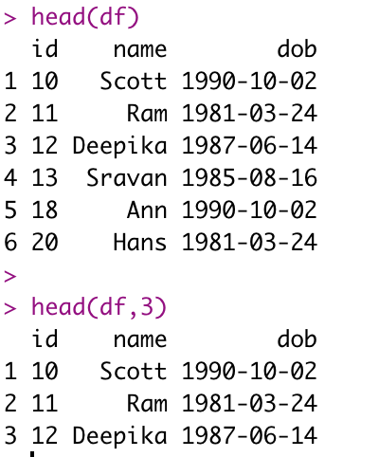
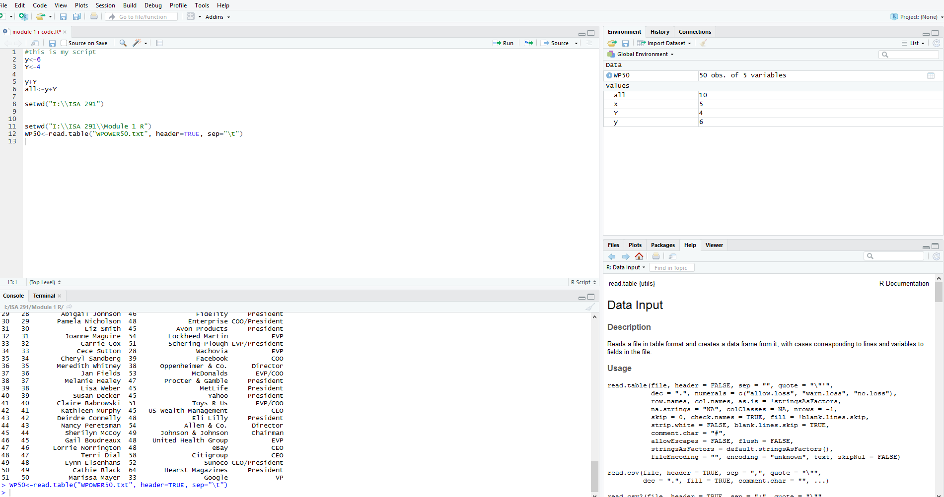
Inspecting the data set
Making sure the data was read correctly

Slide 17
Practice

Slide 18
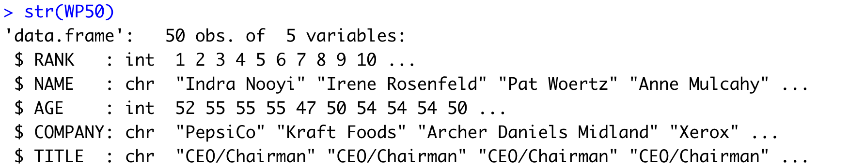
Checking Variable Types
Remember variable types can be
Numeric—continuous number
Integer—1, 2, 3, 5…..etc.
Logical—0/1 or FALSE/TRUE or F/T
Character – Strings (we want to code them as factor instead)

Slide 19
Practice

Slide 20

Other Ways to Read Data
Pre-loaded data sets
Data from packages

Slide 21
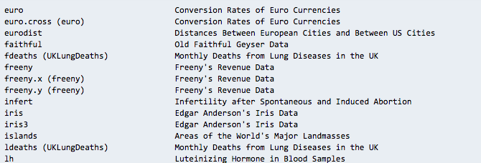
Pre-loaded data sets
You can use the data() function to list pre-loaded datasets
Just use the data as named in the list

Slide 22
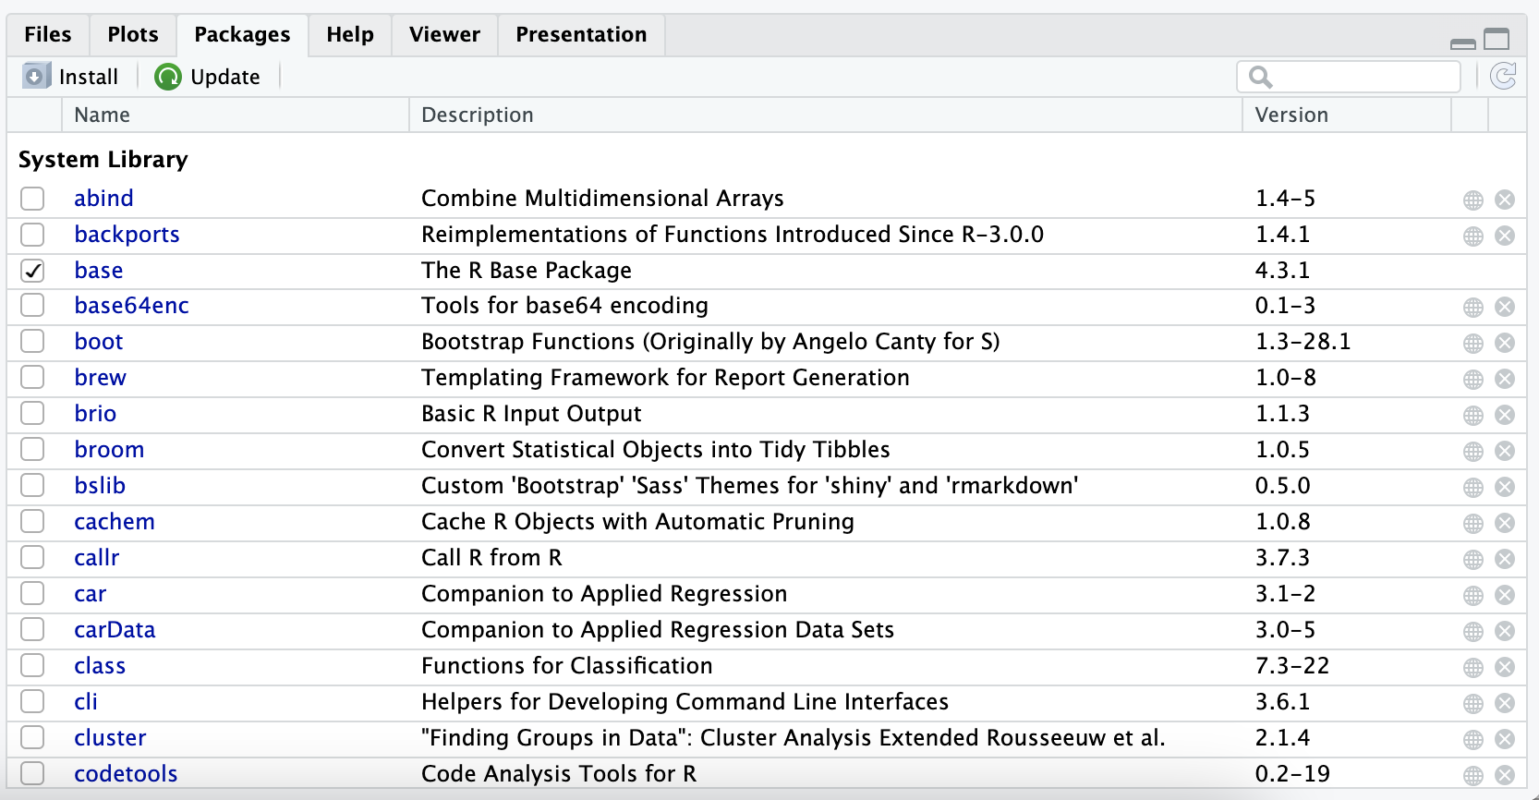
Packages
You can install packages using install.packages()
Make sure to ”load” the package using library()
You can also use the “file, plots, packages,…” panel

Slide 23
Data sets from packages
You can use the data() function after loading packages
Data sets from packages show

Slide 24
Practice

Slide 25
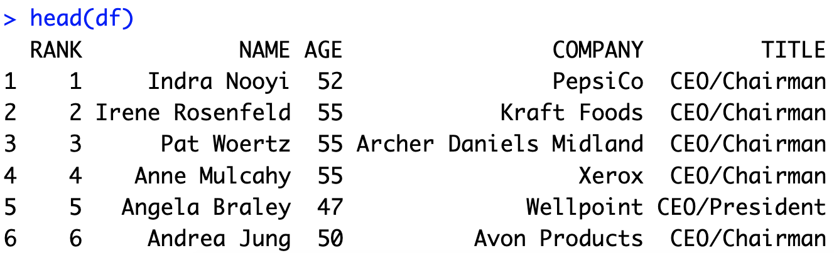
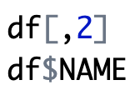
Selecting 1 Variable
You can select variables using indexing
You can also use object $ notation

Slide 26
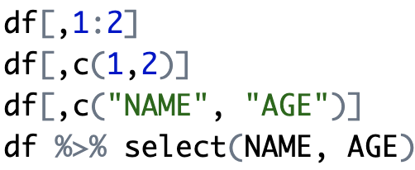
Selecting More than 1 Variable
You can select variables using indexing
You can also use object $ notation
Requires package dplyr

Slide 27
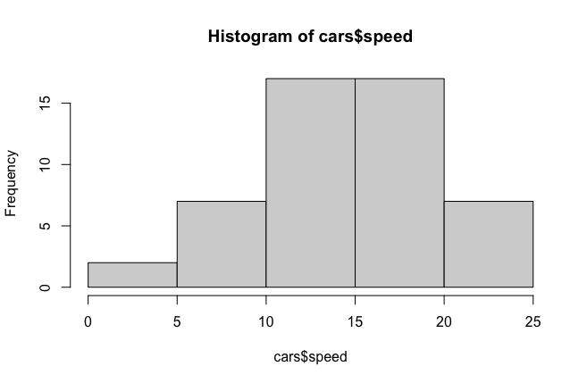
Histograms
Provides a visual representation of the distribution of the data
You can use the function: hist()

Slide 28
Practice

Slide 29
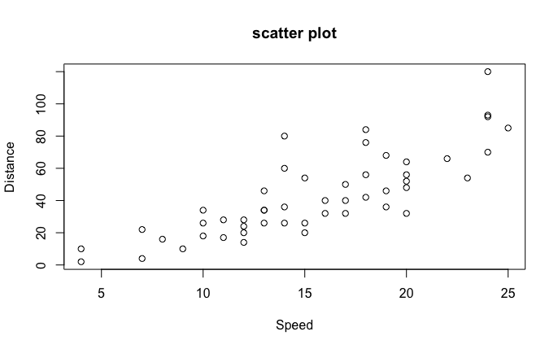
Scatterplot
Provides bivariate relationships
You can use the function: plot()

Slide 30
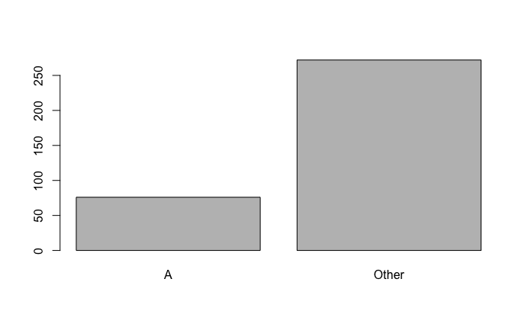
Bar Chart
Provides frequencies of categorical variables
You can use the function: barplot(table())

Slide 31
Subsetting Rows
Used to conditionally select data
You can the bracket notation: [rows, cols]
Conditions for rows
You can use the subset function
Conditions

Slide 32
Practice

